Slide 1
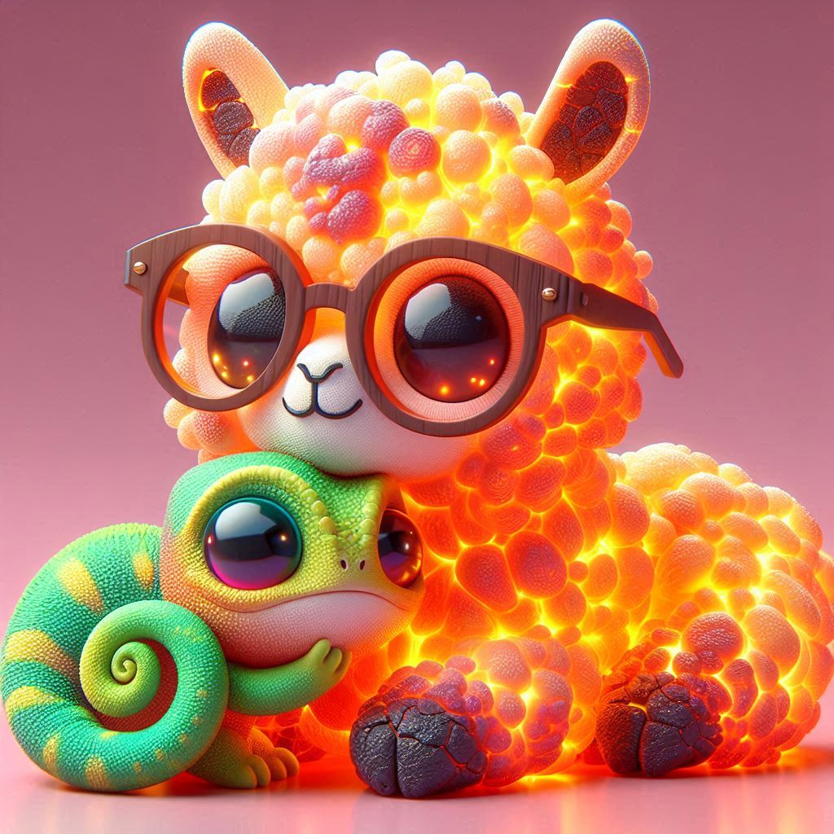
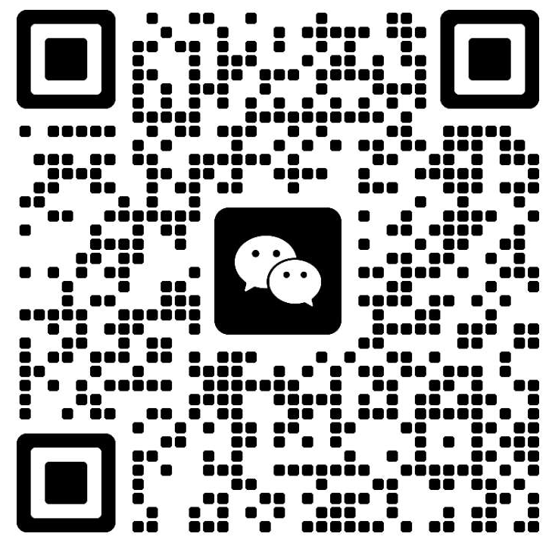



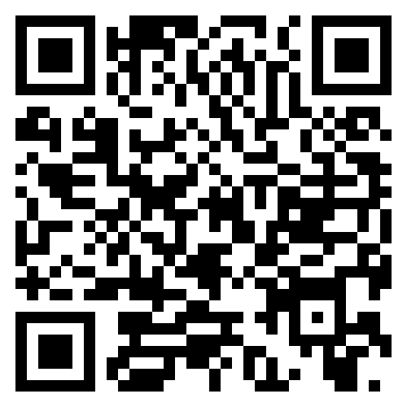
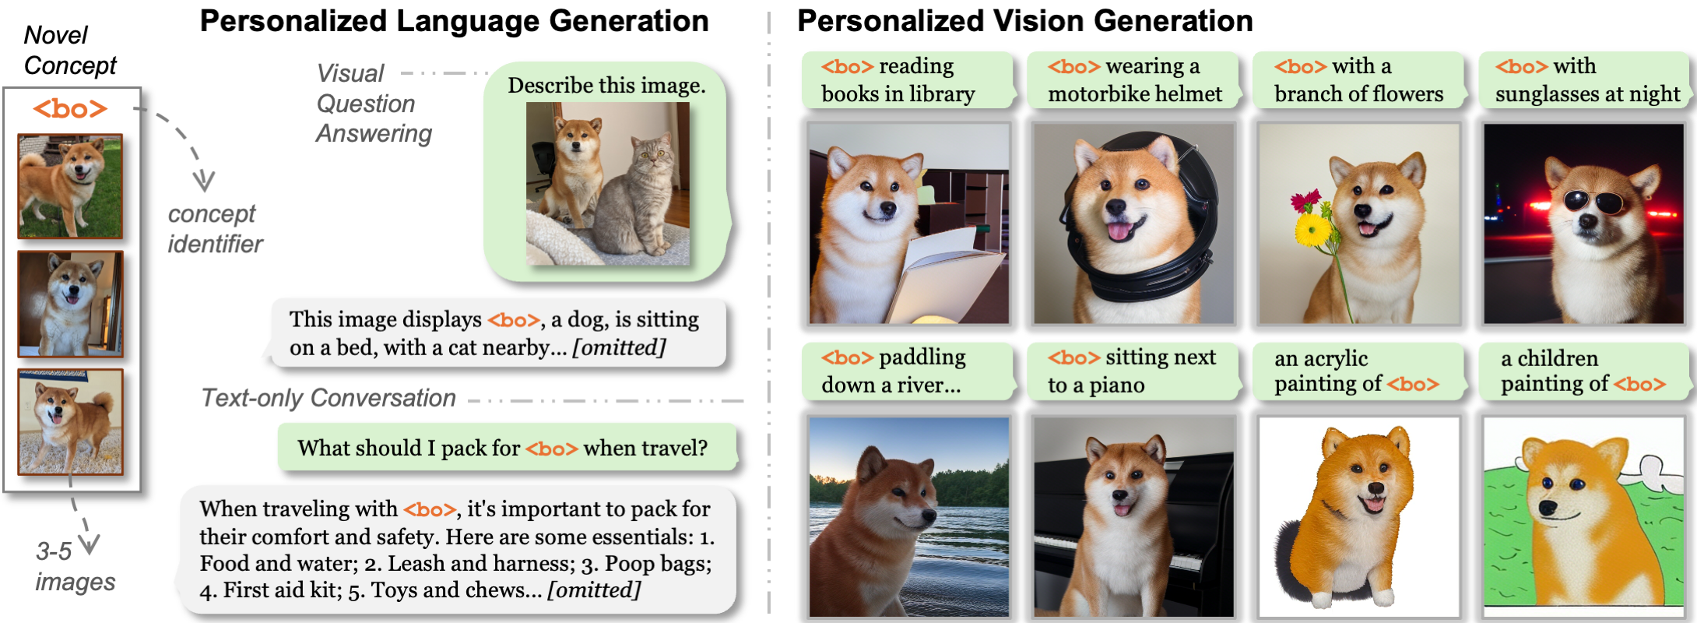
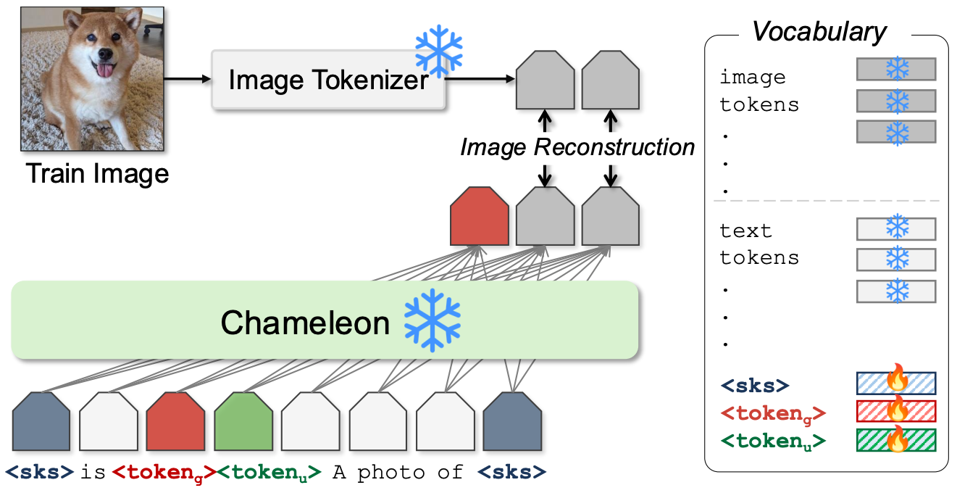
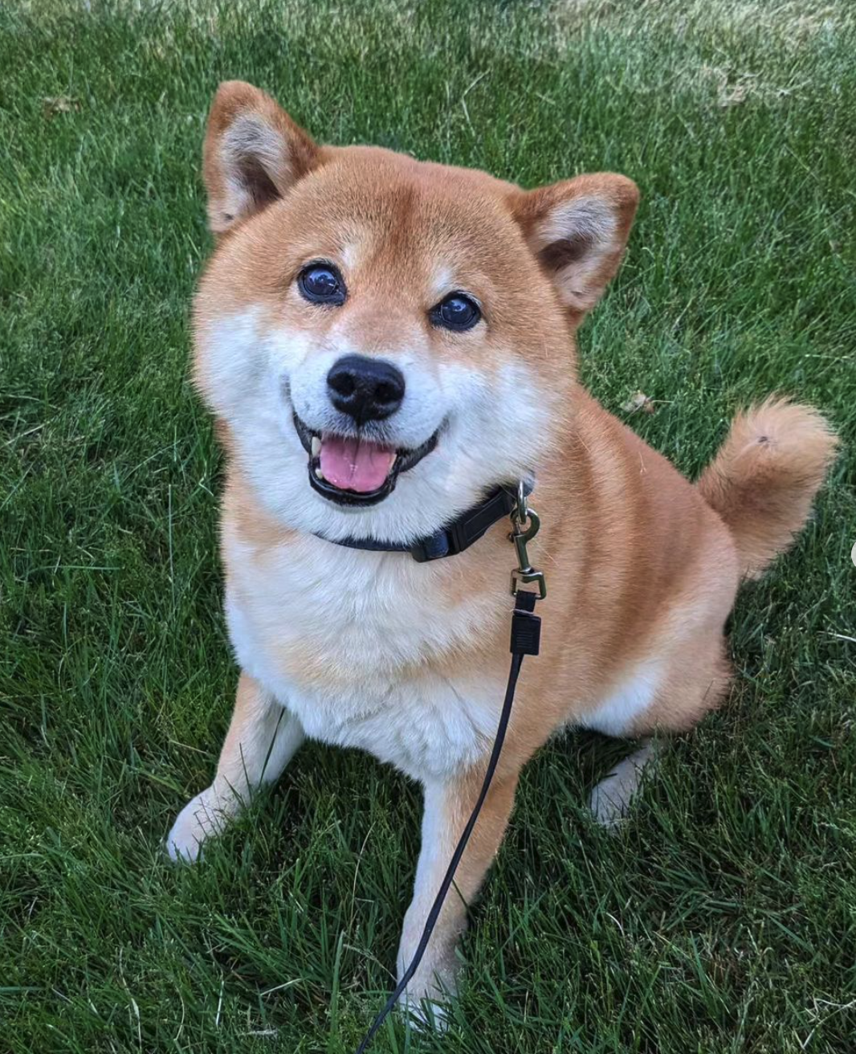
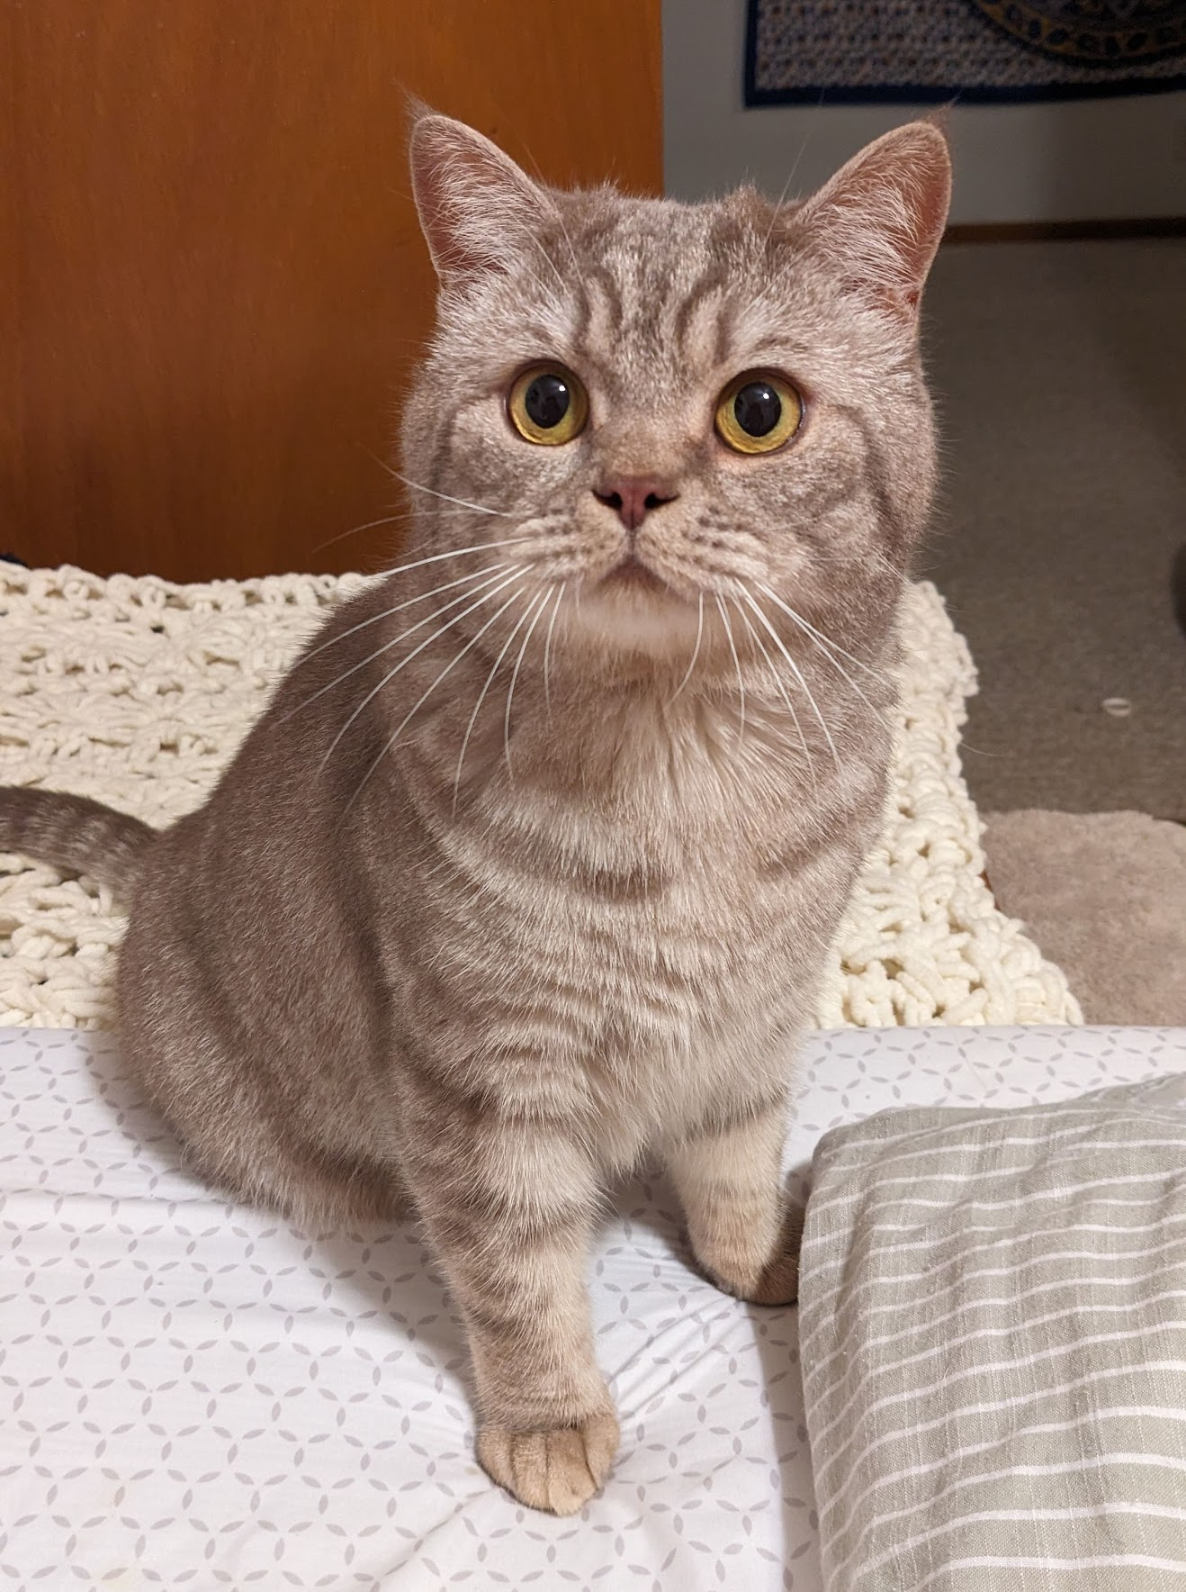
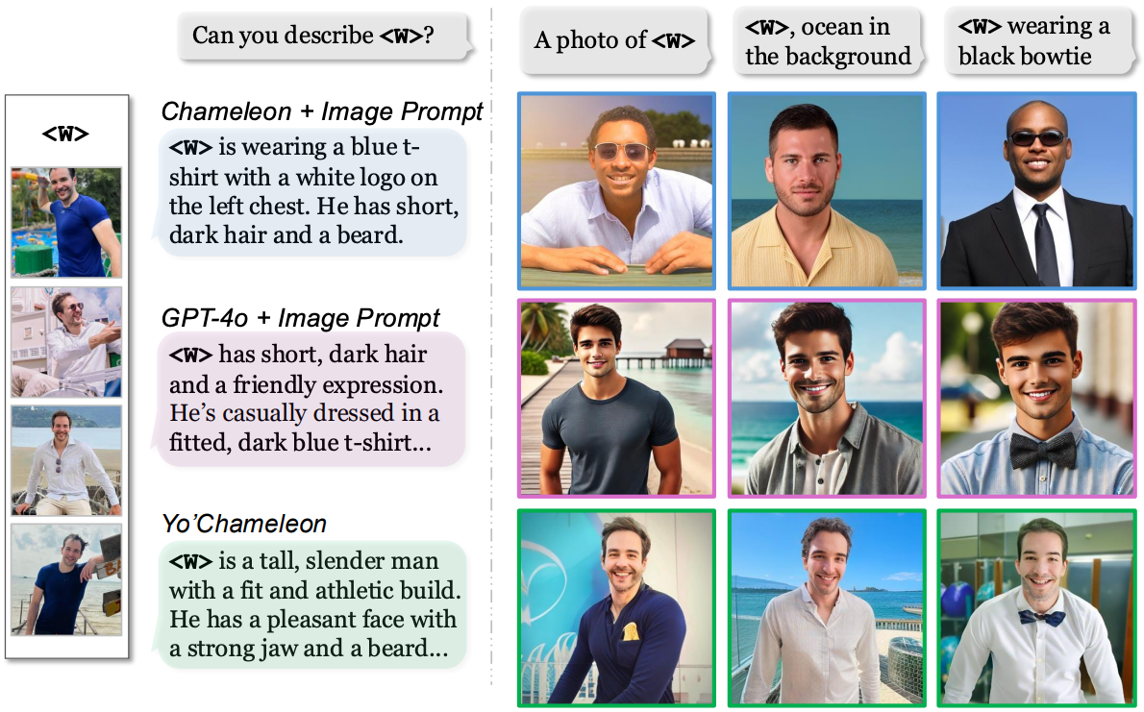
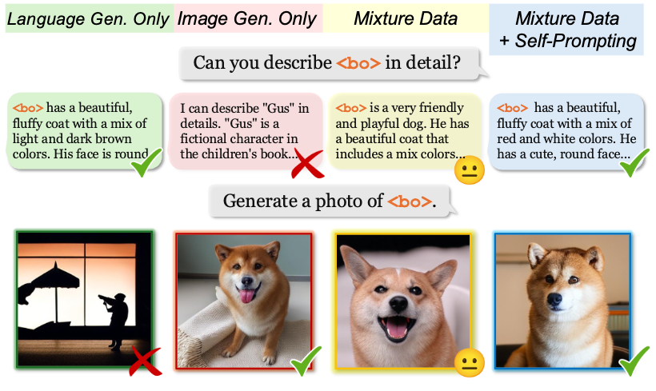
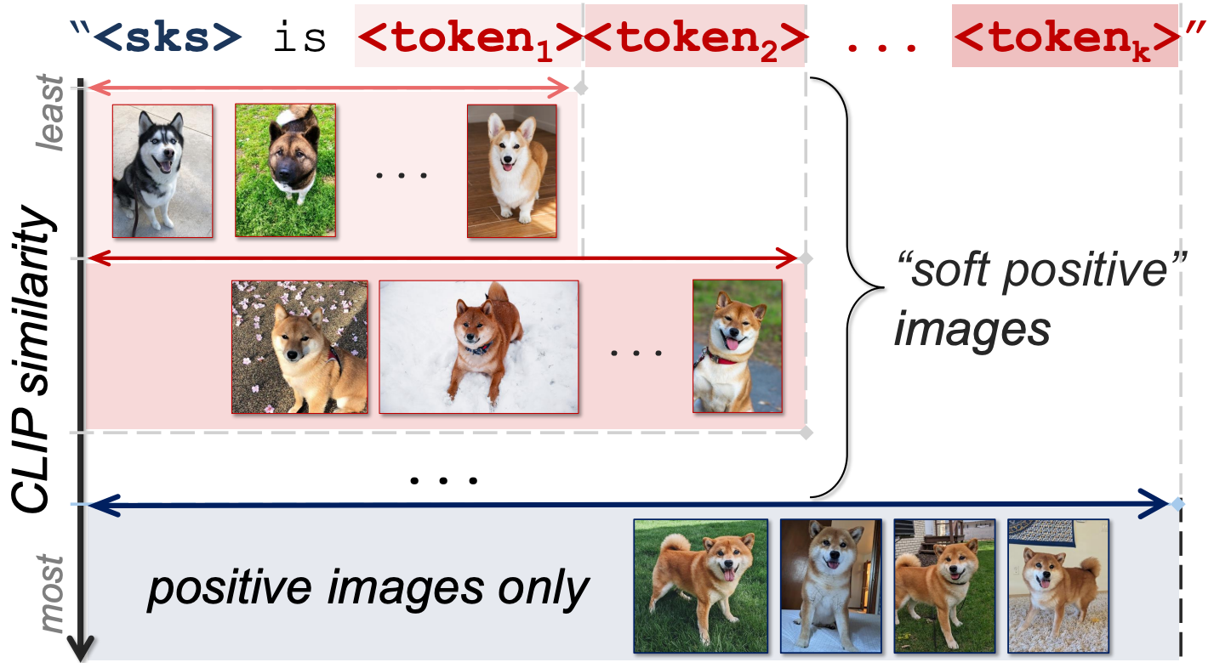
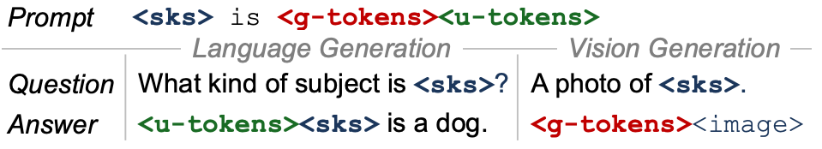
Topics
Multimodal Models
Personalization
Authors
Thao Nguyen¹, Krishna Kumar Singh², Jing Shi²,
Trung Bui², Yong Jae Lee^{1, *}, Yuheng Li^{2, *}
Affiliation
¹UW--Madison
²Adobe Research
Personalized
WeChat
Your Personalized Vision & Language Assistant
Large Multimodal Models
APPROACH (YO’CHAMLEON)
How to make LMMs understand personalized concept?
novel concept
3-5 images
We represent personalized subjects as learnable prompts for LMMs:
“<sks> is <g-tokens><u-tokens>.
✓ retain original capabilities
✓ personalized conversations
WeChat
WHAT’S NEXT
Training data:
(1) Understanding: Recognition
& Question-Answering (Yo’LLaVA);
(2) Generation: Image Reconstruction.
Zero-shot personalization? Multiple concepts? etc.
“This is Bơ - my dog. Bơ is brother of Mắm - my cat…”
←← Scan QR for paper, page, & code!
WHY DIFFICULT?
3S: Soft-prompt + Soft-positive + Self-prompting
Soft-prompt: Personalized subject = Soft-prompt.
Soft-positive images.
Retrieved images are ranked according by similarity to positive images. Images that are more similar to the actual positive images are described with more latent tokens (i.e., more details).
Self-prompting mechanism.
Model first predicts which information should be used first, then preform the task.
Optimized tokens for one task cannot effectively perform another.
And training on a mixture of data yields suboptimal performance across tasks.

