Slide 1








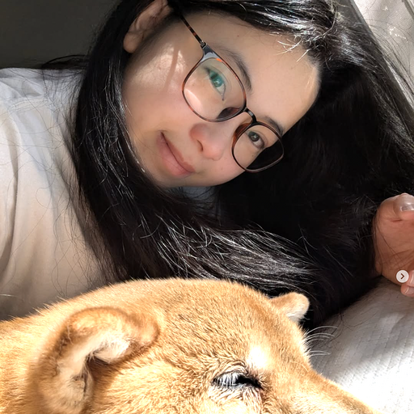
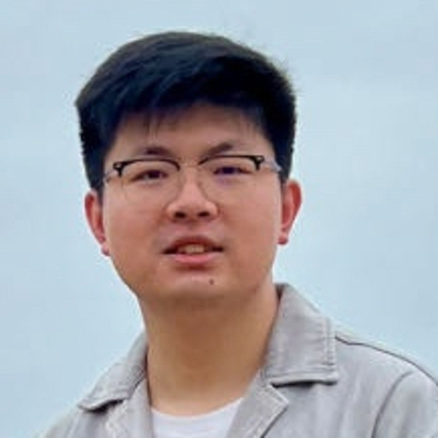
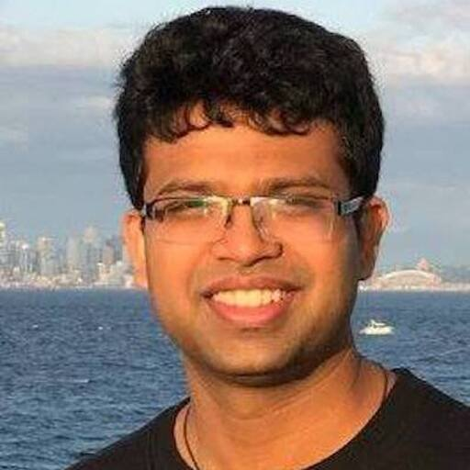
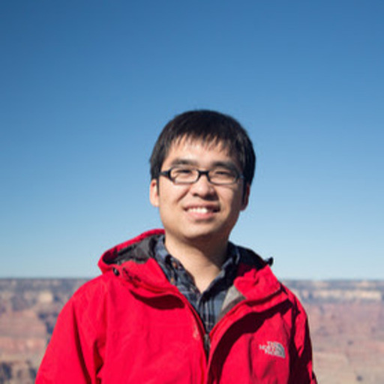
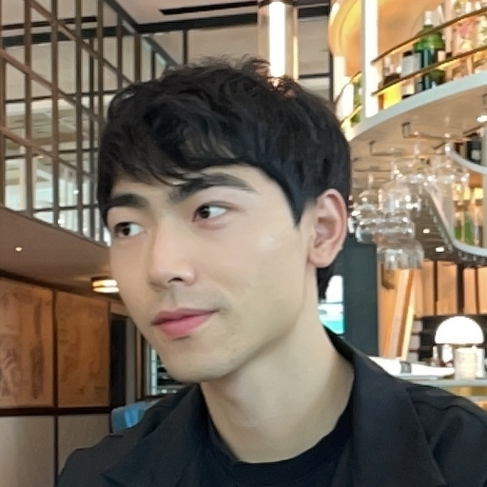

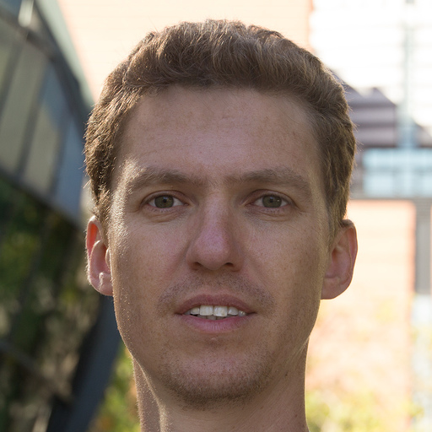
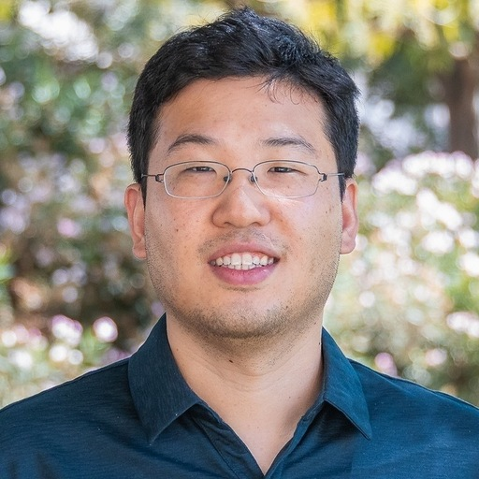
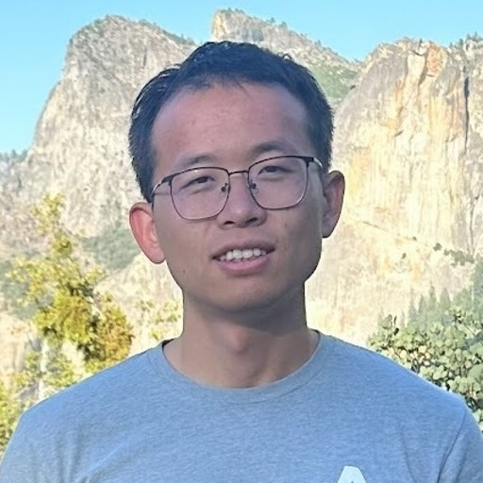
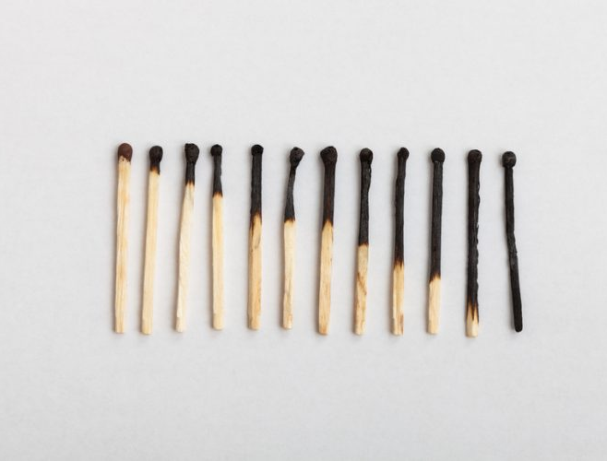

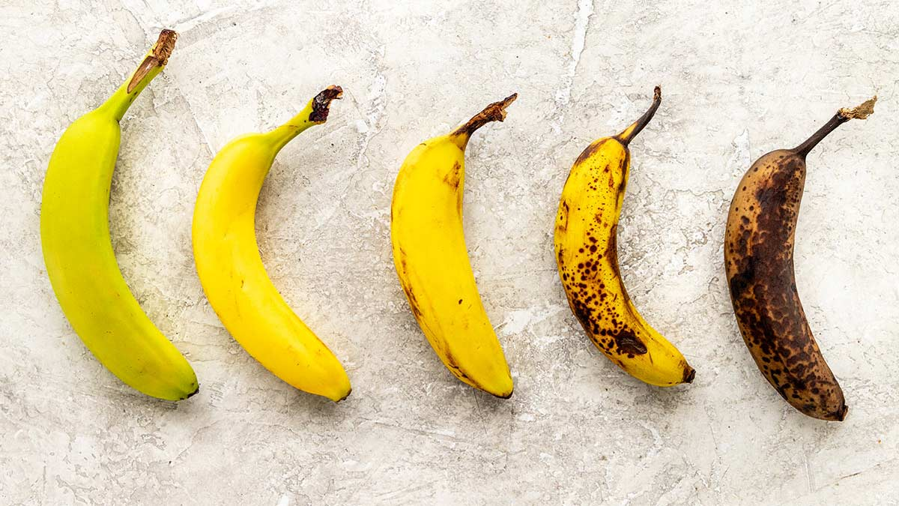

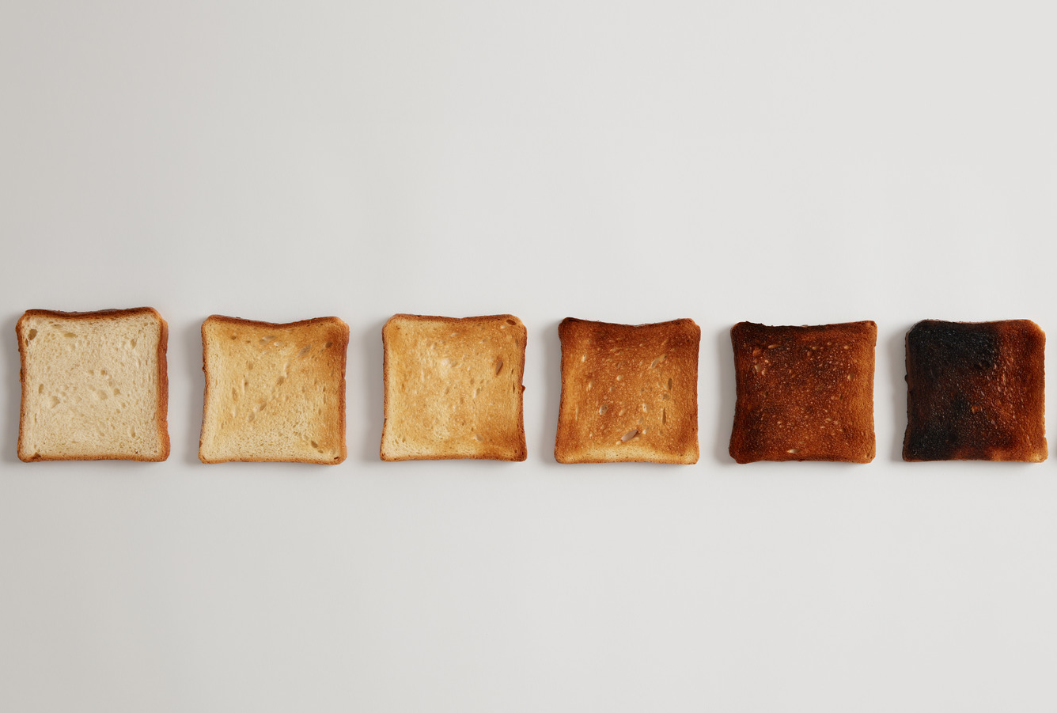
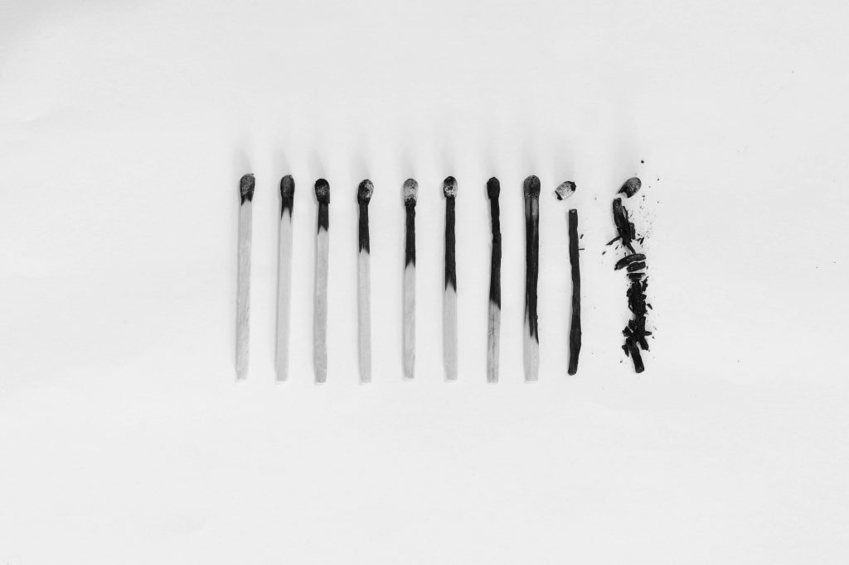

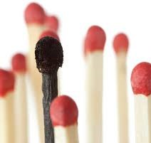

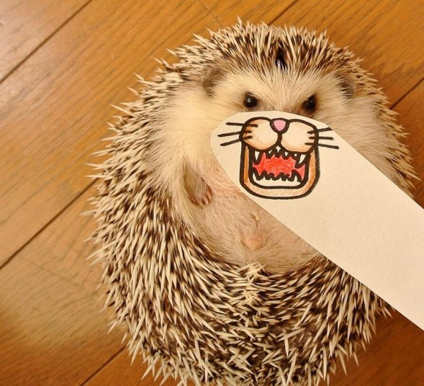
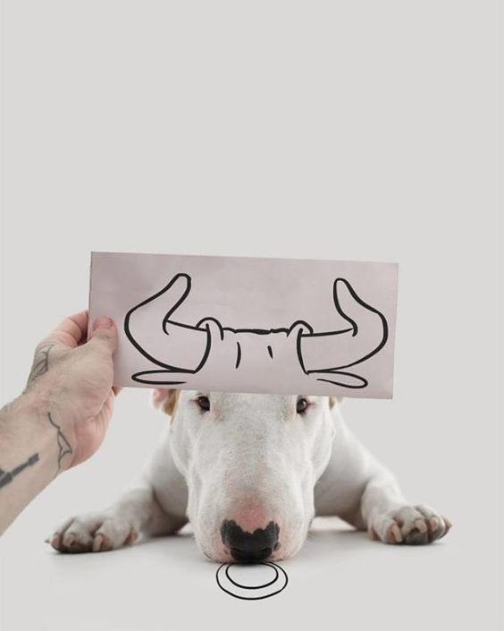
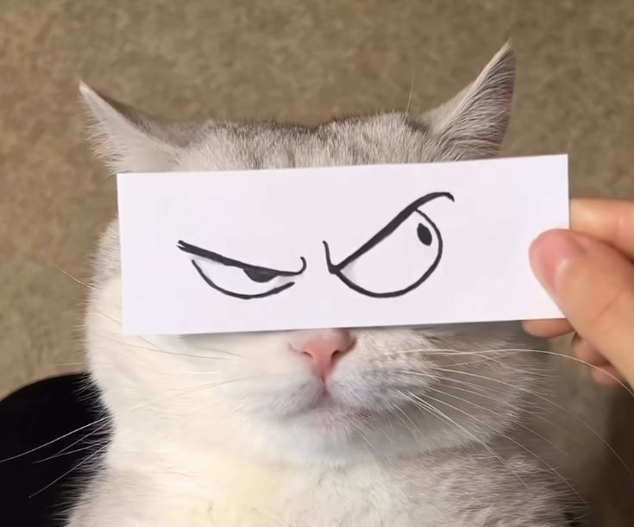
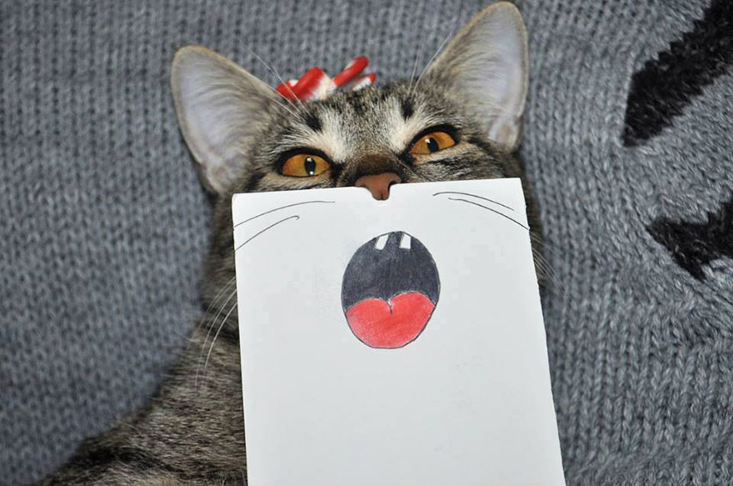

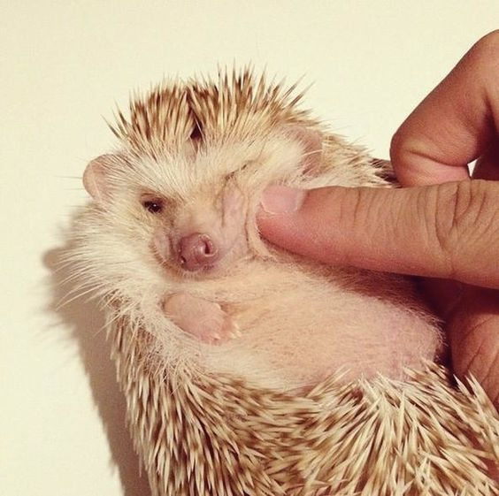
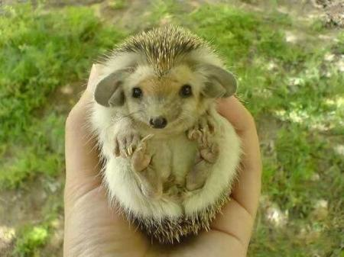
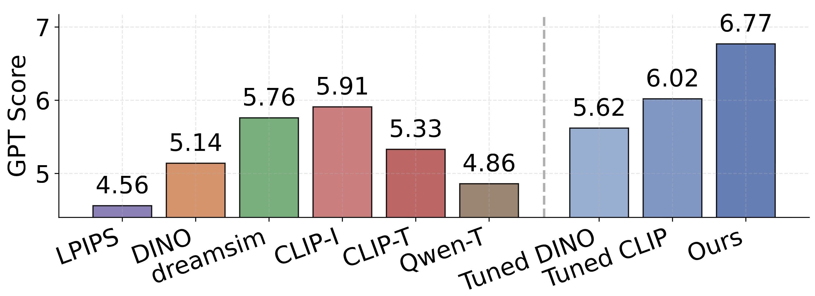
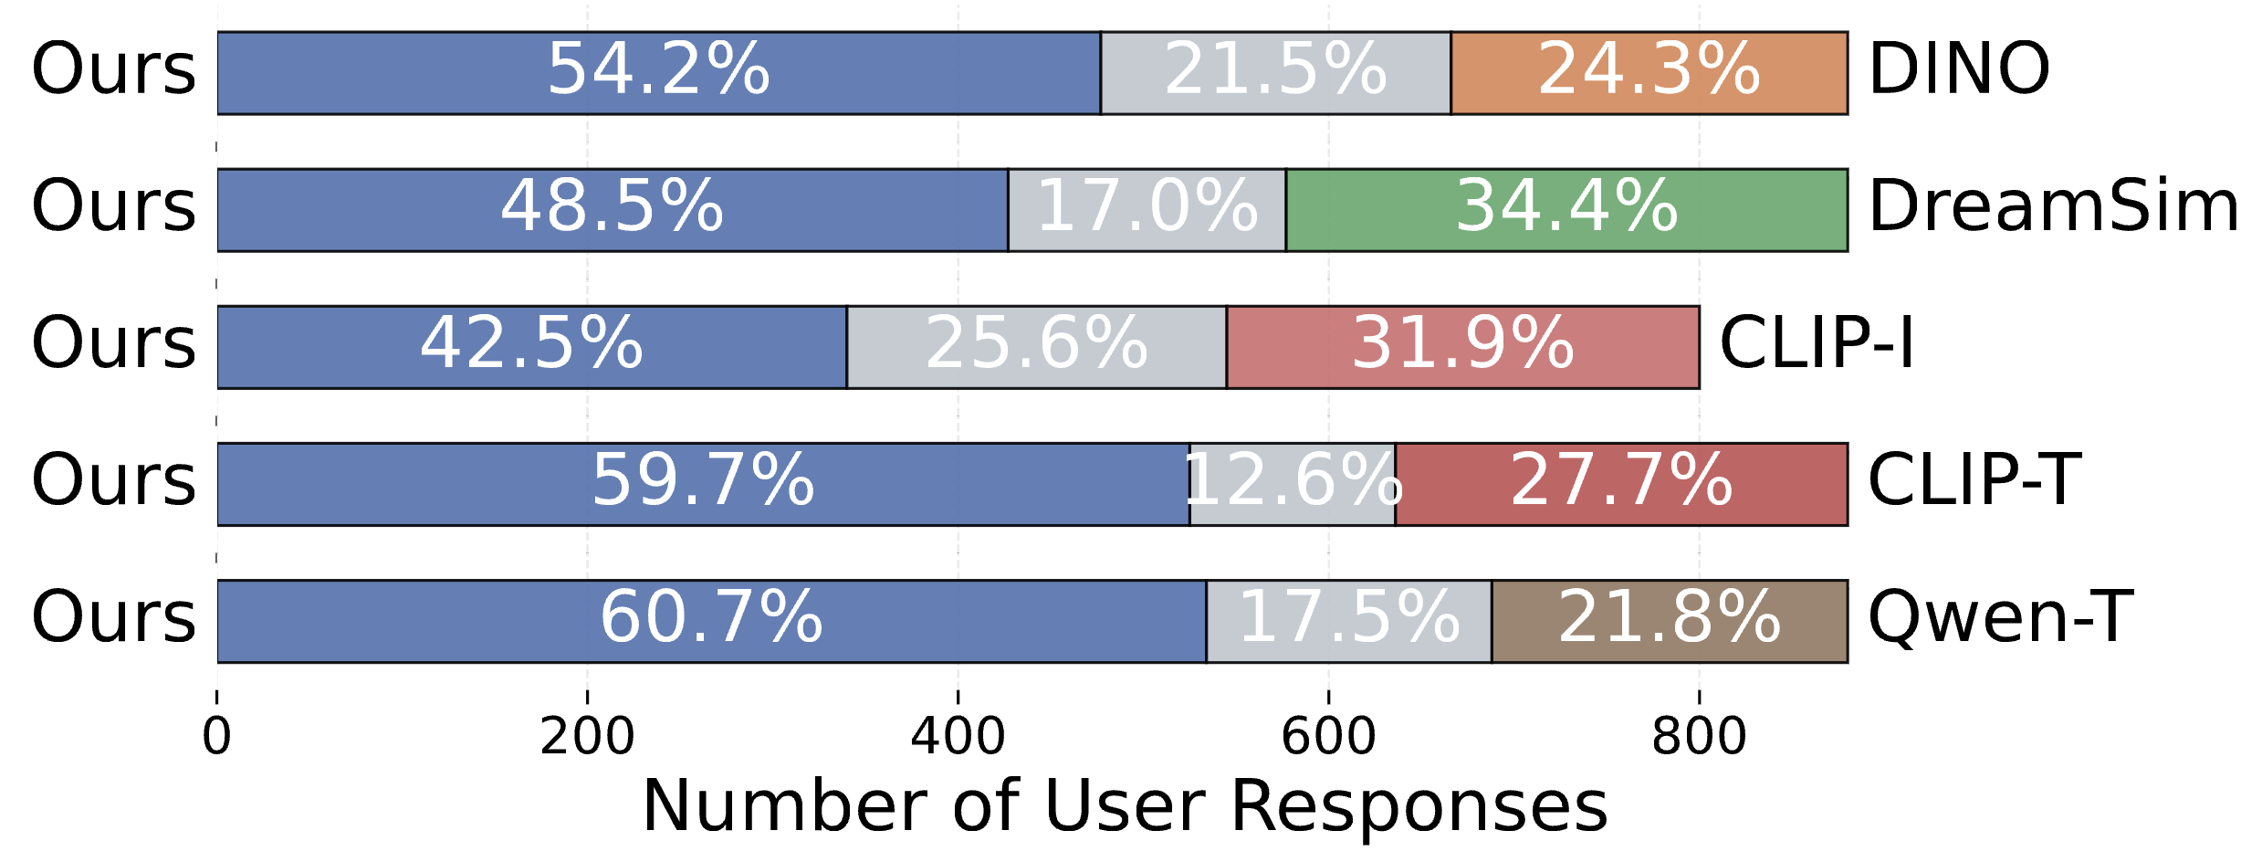
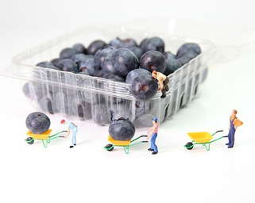

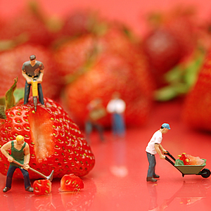
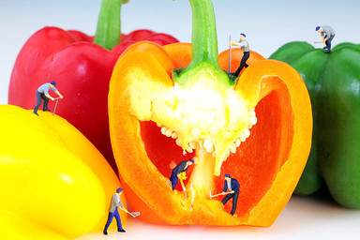
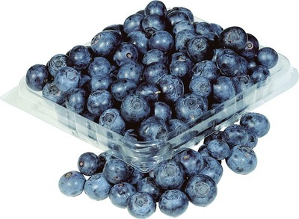
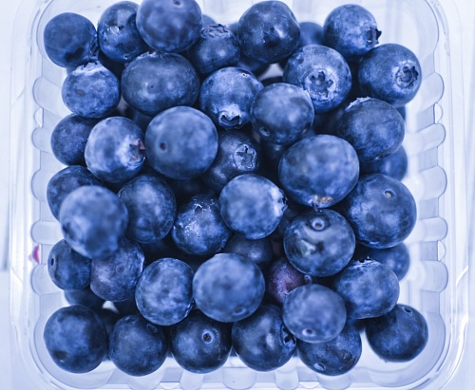
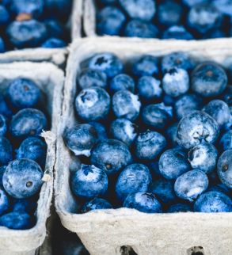


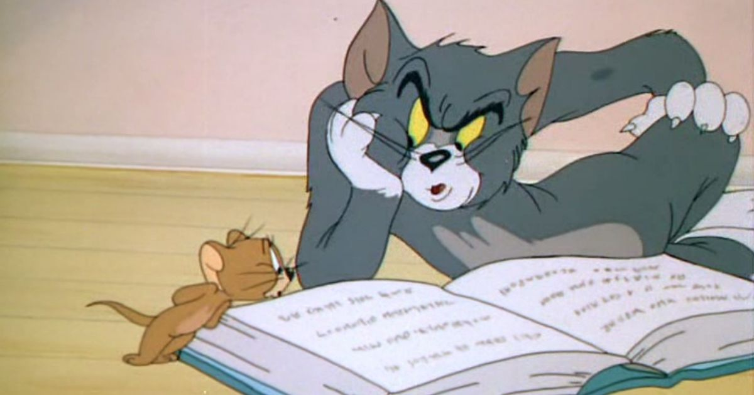
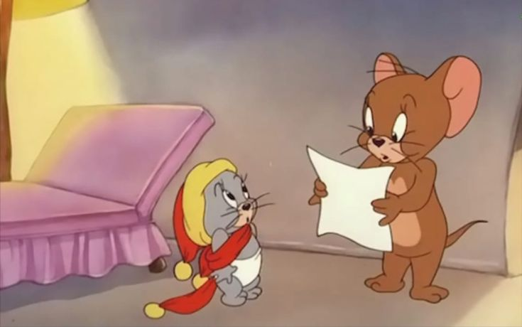


which one is more similar: A or B??
You mean like this?
# relational-visual-similarity
Group A
Reference 1
Group B
Yuheng Li [last author] 3:24PM
@thao have you created poster for relsim? Today’s presentation day!!!
Thao Nguyen [first author] 3:30PM
I’m doing…Do u think these figures are sufficient? Btw which poster style?
relsim-approach-figure---create-data-and-training.png
Group A
Reference 2
Group B
relsim-quantitative-and-user-survey.png
Group A
Reference 3
Group B
Yuheng Li [last author] 4:01PM
The content matter, not the style. Also please add link to our new project?
Thao Nguyen [first author] 4:20PM
You mean like this? But in which style? Any good poster template?
*authors
*CVPR audience
#Similarity Space: relational vs. attribute
#Application: Image retrieval
*authors
*CVPR
audience
new project
Yuheng Li [last author] 4:20PM
THAO, AGAIN, STYLE DOESN’T MATTER!
JUST PRINT the poster and BRING it to Convention Center NOW!!!

Slide 2

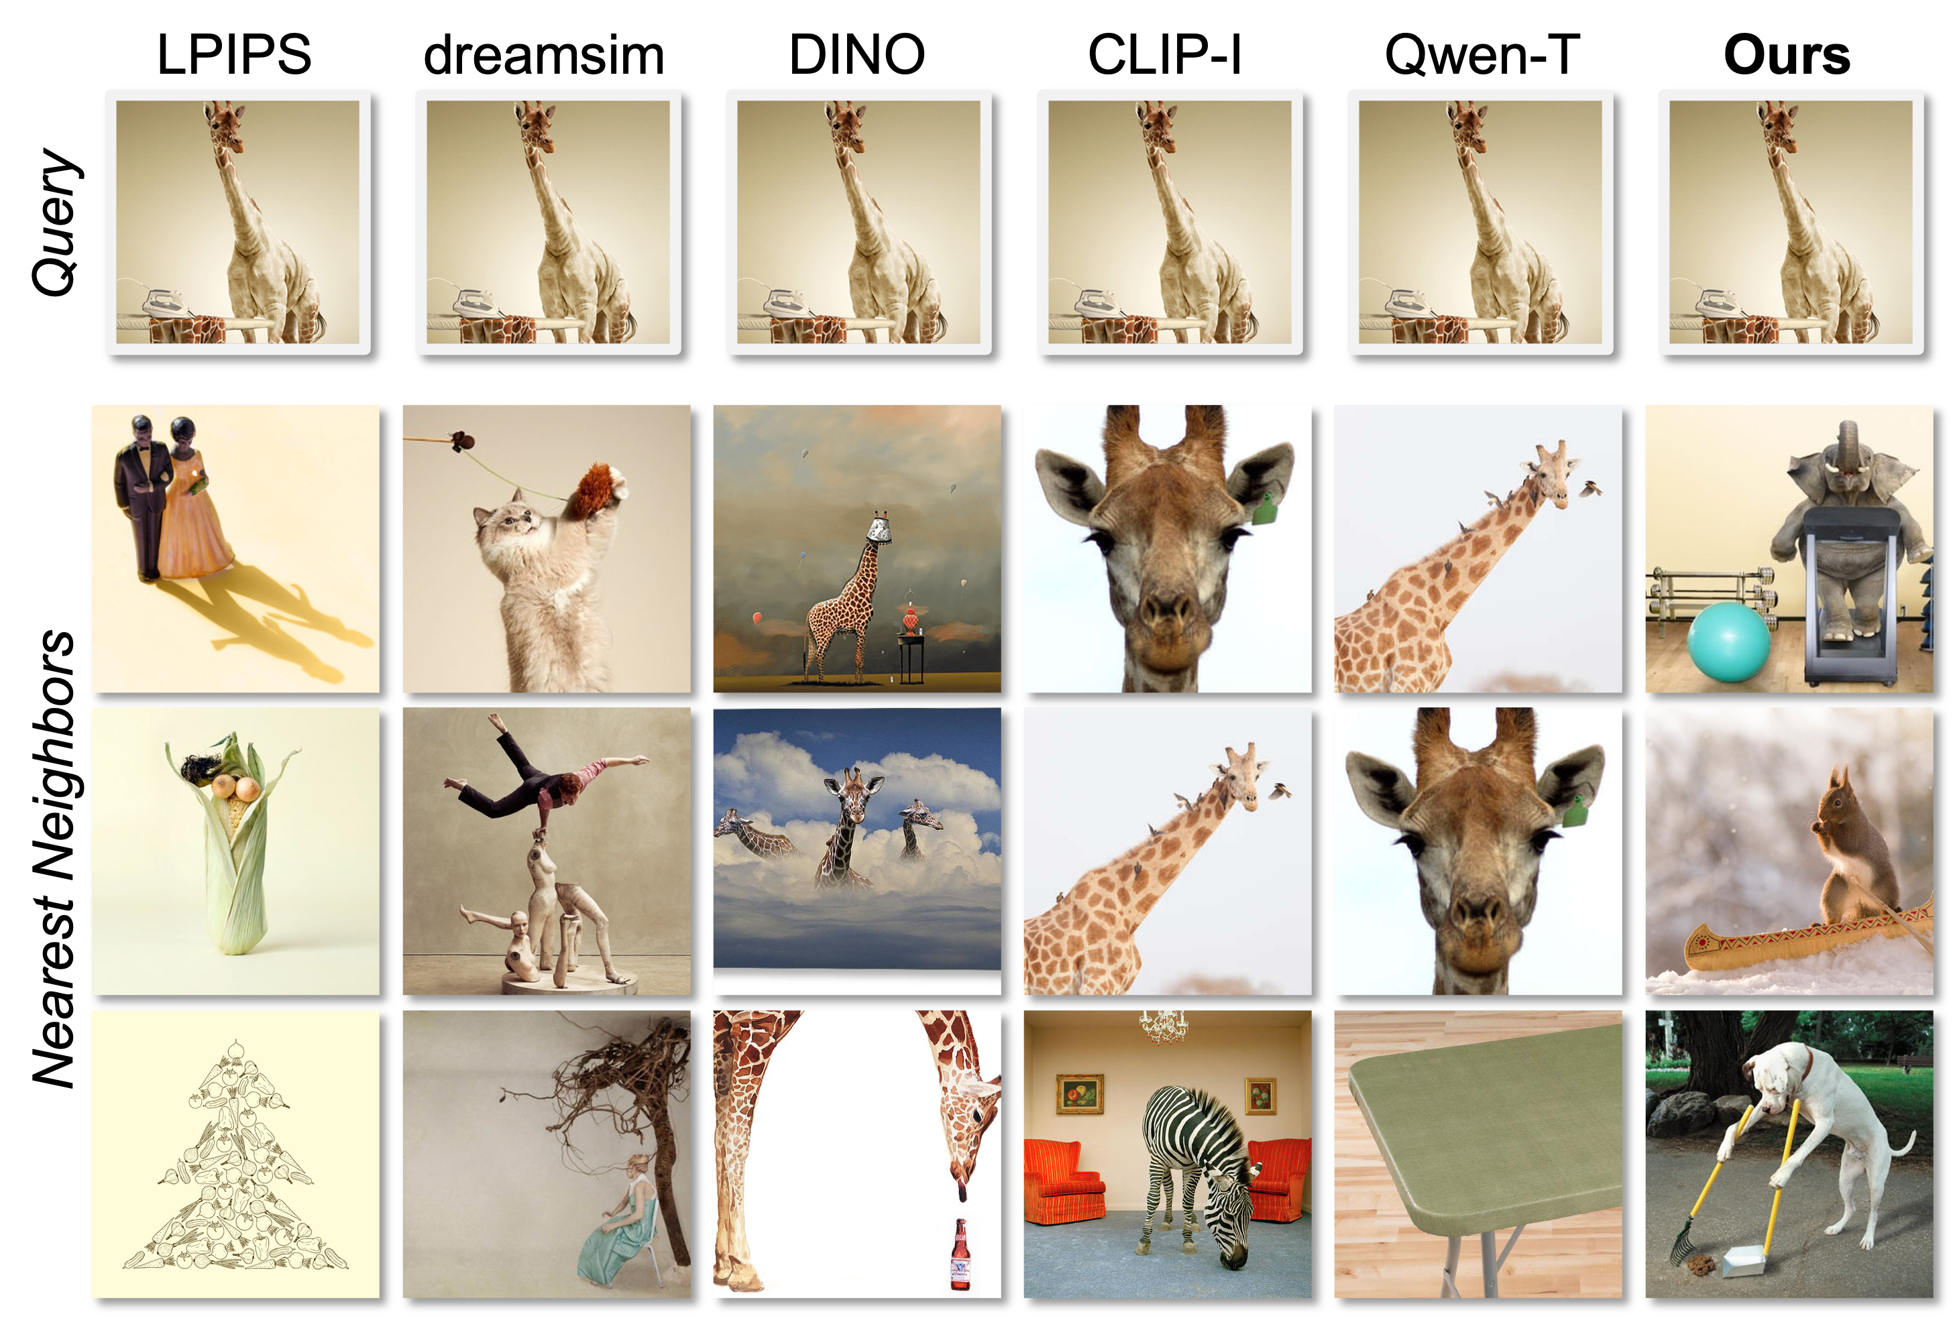

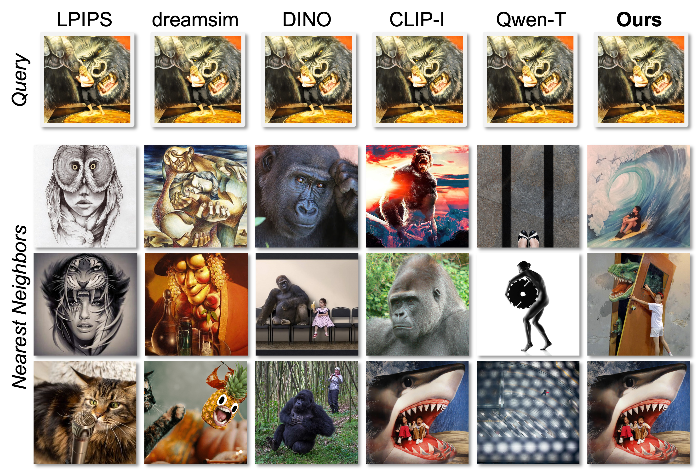
which one is more similar: A or B??
# relational-visual-similarity
Group A
Reference 1
Group B
Yuheng Li [last author] 3:24 PM
@thao have you created poster for relsim? Today’s presentation day!!!
Thao Nguyen [first author] 3:30 PM
I’m doing…Do u think these figures are sufficient?
relsim-approach-figure---create-data-and-training.png
Group A
Reference 2
Group B
relsim-quantitative-and-user-survey.png
Group A
Reference 3
Group B
Yuheng Li [last author] 4:01 PM
What? Why you are still working on poster?
No one read your poster, please work on the new project now
Thao Nguyen [first author] 4:20 PM
What do you mean? I can’t present my new project at CVPR any way???
*authors
*CVPR audience
#Similarity Space: relational vs. attribute
#Application: Image retrieval
More examples,
Paper
and CODE!
*authors
*CVPR
audience
new project
Yuheng Li [last author] 4:21 PM
Yes you can. And, THAO, AGAIN, POSTER ASTHETIC DOESN’T MATTER!
JUST PRINT the poster and BRING it to Convention Center NOW!!!
Thao Nguyen is typing… Thao stopped typing… [Thao has left the channel]

