Slide 1
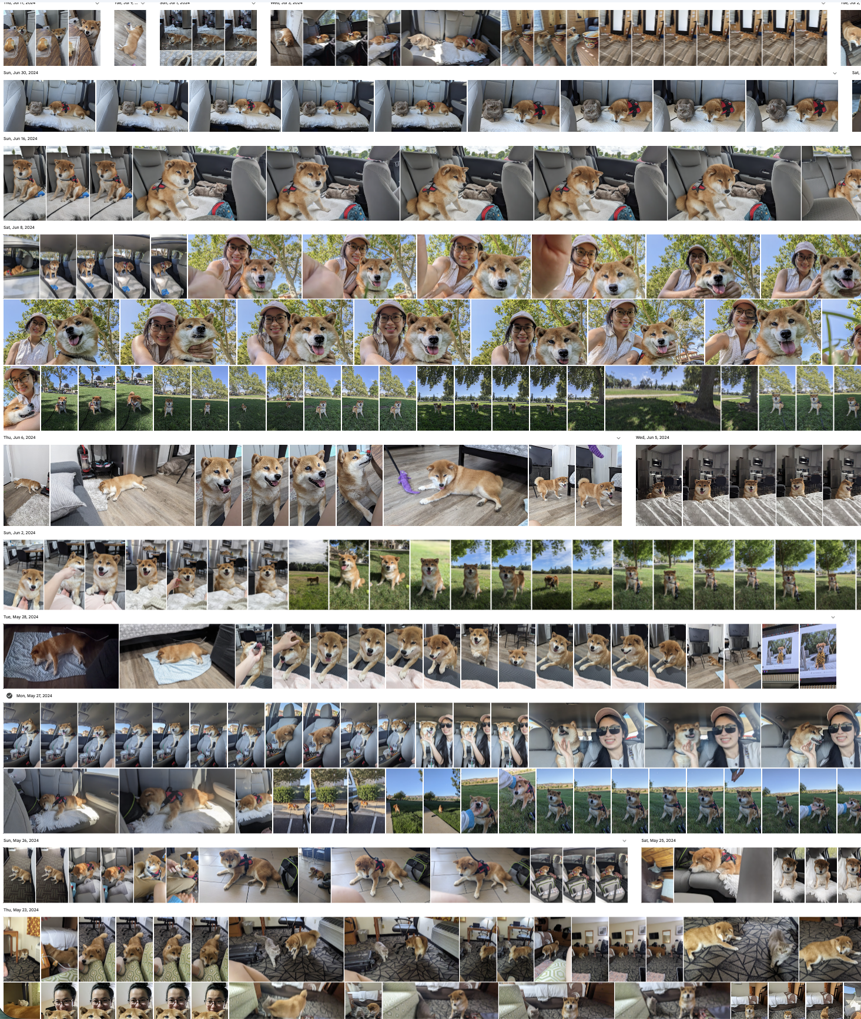

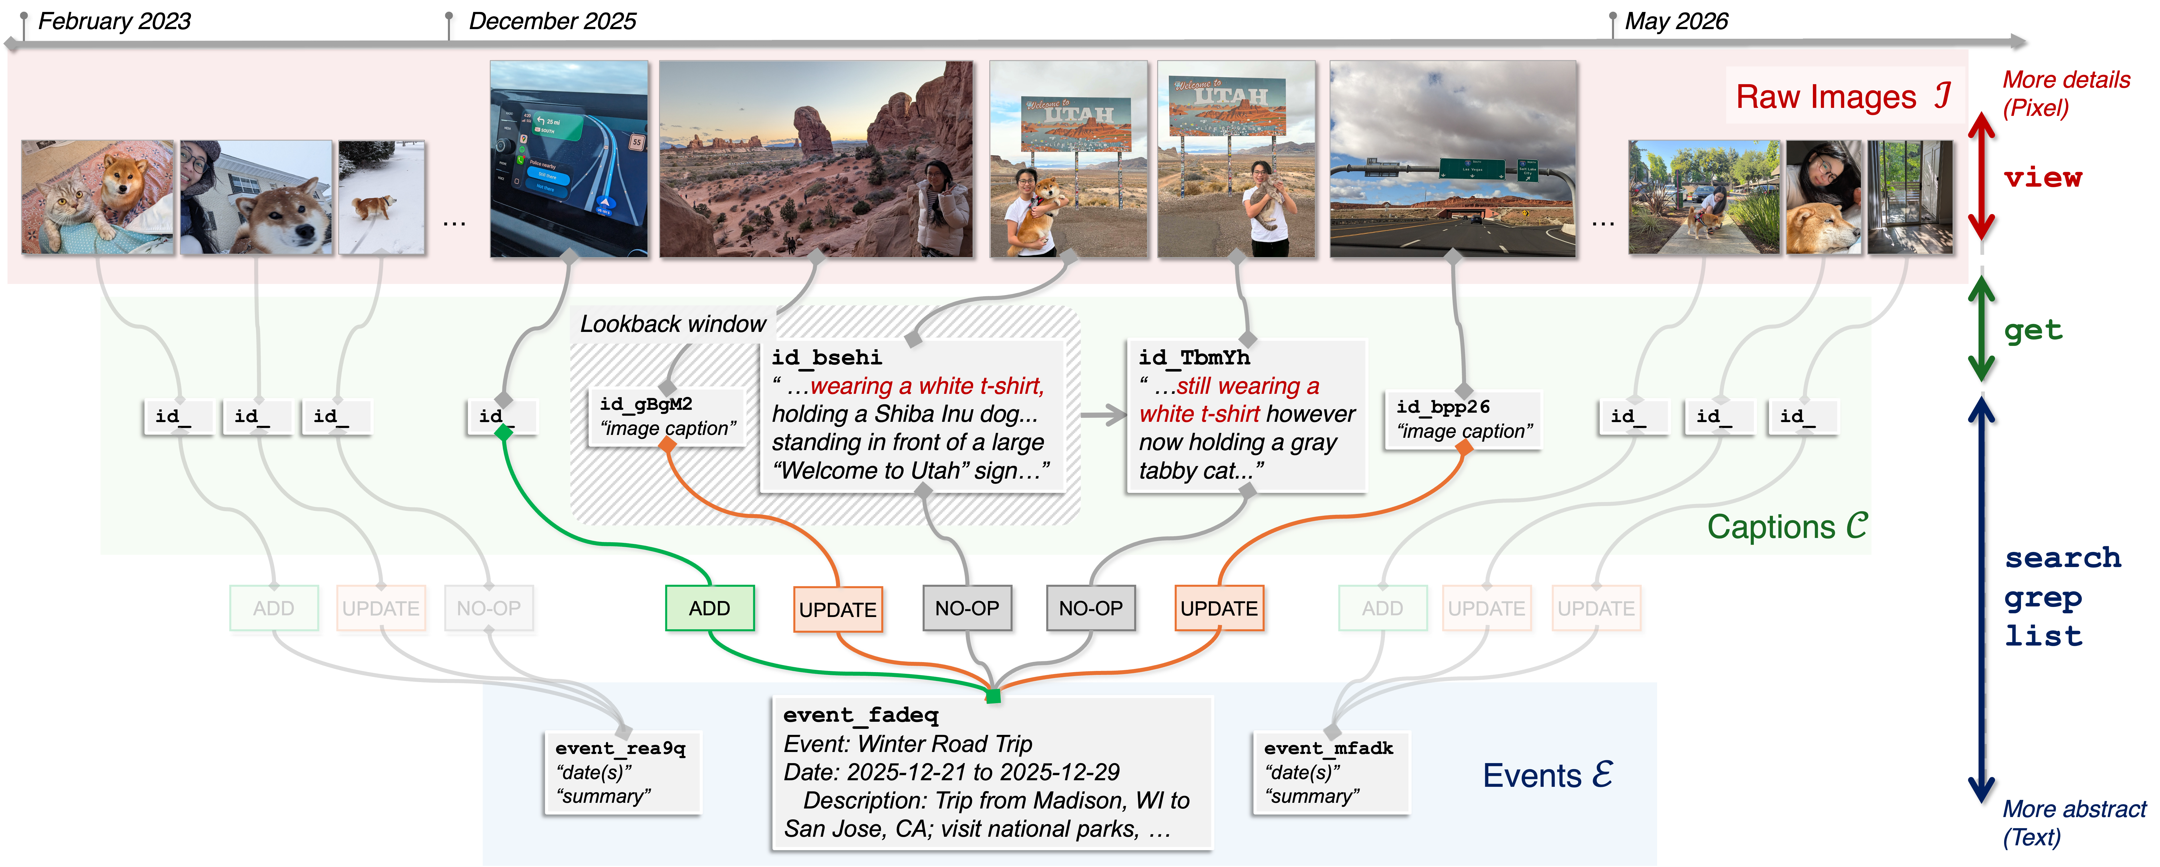
You have 3000+ photos!
(in our phone, laptop, camera, etc.)
Me too :)
That’s SUPER rich, dense data about you, waiting to be useful.
We started doing something with it (:
How about you? What will you do?
Let’s chat about this :D
Fig. 1: We study the VQA on personal camera roll, where an AI can access thousands of user images.
Fig. 2: Hierarchical memory: low-level visual pixels (I) to higher semantic abstractions (captions C, events E). Agent interactions are designed accordingly: expensive tool (view, get) to cheaper one (search, grep, list).

